Slide 1
Calculating z - score

Slide 2
REMEMBER? box and whisker plot
Middle 50%
LQ
UQ
range

Slide 3
Standard deviations from the mean

Slide 4
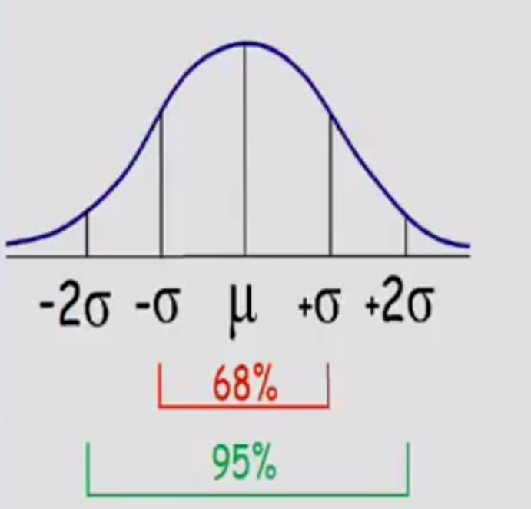
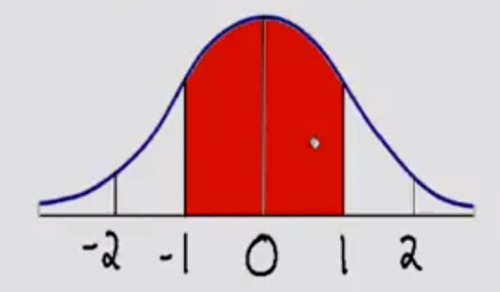

Slide 5
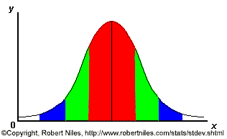
68-95-99.7 Rule
68.3% of the data
95.4% of the data
99.7% of the data
Notes:
SAY: within 1 standard deviation either way of the mean
within 2 standard deviations of the mean
within 3 standard deviations either way of the mean
WORKS FOR ALL NORMAL CURVES NO MATTER HOW SKINNY OR FAT

Slide 6
Simple problems can be solved using the imperial rule
<-3 | -3 to -2 | -2 to -1 | -1 to 0 | 0 to 1 | 1 to 2 | 2 to 3 | >3
0% | 2% | 14% | 34% | 34% | 14% | 2% | 0%
The heights of students at a college were found to follow a bell-shaped distribution with μ of 165cm and σ of 8 cm.
What proportion of students are taller than 173 cm?

Slide 7
68-95-99.7 Rule
68.3% of the data
95.4% of the data
99.7% of the data
Notes:
SAY: within 1 standard deviation either way of the mean
within 2 standard deviations of the mean
within 3 standard deviations either way of the mean
WORKS FOR ALL NORMAL CURVES NO MATTER HOW SKINNY OR FAT

Slide 9
Exercise 1
The grades on statistics final exam for CNR students are normally distributed with µ = 81 and σ = 6.3. Calculate the z score for each of the given grades:
65 =
83 =
93 =
100 =
= -2.54
= 0.32
= 1.9
= 3.02

Slide 10
Exercise 2
Assume that the weight of 1 year old girl in your village is normally distributed with a mean of 9.5 kg with a standard deviation of 1.1 kg. Estimate the percentage of 1 year old children that fall within the given criteria:
Less than 8.4 kg
Between 7.3 kg and 11.7 kg
More than 12.8 kg
= 16%
= 95%
= .15%

Slide 11
Exercise 3
The statistics exam of CNR students for the year 2015 were not normally distributed with µ = 2.80 and σ = 1.34. What is the approximate z score (given below) that corresponds to an exam score of 5.
0.786
1.46
1.64
2.20
= 1.64

Slide 12
Exercise 4
The height of SD boys in statistics class is normally distributed with a mean height of (µ ) 143.5 cm and a standard deviation (σ ) of about 7.1 cm. What is the probability that a randomly selected boy from SD class would be taller than 157.7 cm?
= 2.5%

Slide 13
Exercise 5
If a normal population of 1000 body weights has a mean (µ ) of 70 kg, standard deviation (σ ) = 10, what proportion of the population is greater than 85 kg?

Slide 14
Z Table for reference

